Slide 1
University American College Skopje
Course: Business Computer Applications
Industry 4.0 digital transformation – part I
Marija Stanojeska, PhD

Slide 2
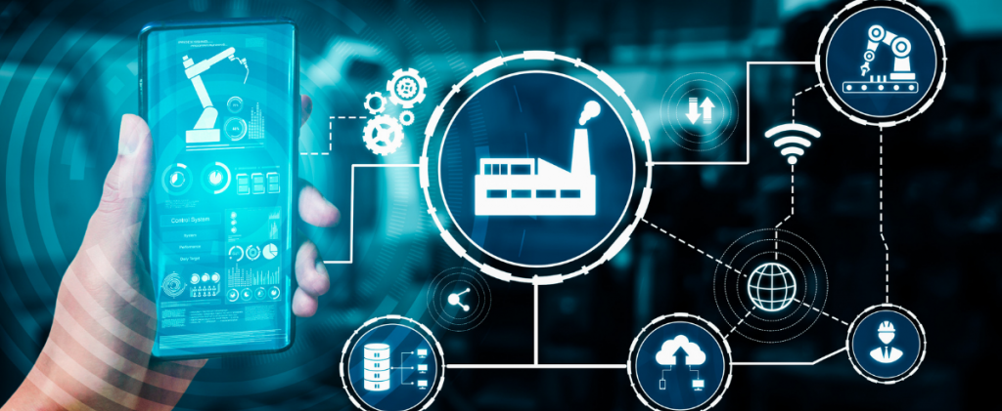
Based on the textbooks:
Industry 4.0: Managing The Digital Transformation, Ustundag A., Cevikcan E.
Industry 4.0: The Industrial Internet of Things, Gilchrist A.

Slide 3
Lecture overview
Basic information related to Industry 4.0
Explanation of the design principles of 4th industrial revolution
Analyze of the driving Industry 4.0 technologies
Description of the benefits and challenges of implementation of the Industry 4.0 concept
Introducing the concept of smart factory
Exercises

Slide 4

What is Industry 4.0?
“Industry 4.0 is more than just a flashy catchphrase. A confluence of trends and technologies promises to reshape the way things are made.”
Cornelius Baur and Dominik Wee, McKinsey & Company

Slide 5
Why is Industry 4.0 important for the business?
The main reason why Industry 4.0 is so important for business is that it allows to improve the efficiency of all companies operations, from manufacturing through supplies to distribution. This, helps to produce more high-quality products in a shorter time.
In addition to maintaining or improving the quality of your products, implementing Industry 4.0 allows companies to monitor equipment in real time. Using wireless sensors and data-analyzing systems enables to control every stage of the production process and respond promptly to any technical issues that may arise. This also prevents downtime, helps with scheduling machinery maintenance, and boosts productivity.
Industry 4.0 technologies can also be applied in the area of health and safety at work.

Slide 6
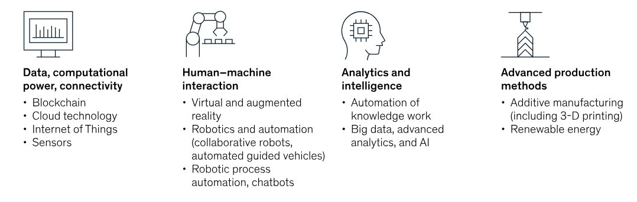
Delivering value across each area of the factory
The digitally enabled factory of today looks very different from the leading factory of ten years ago. Advances in data and analytics, Artificial Intelligence, and Machine Learning - and the array of technology vendors in the market - mean manufacturers can choose from hundreds of potential solutions and tech applications to improve their ways of working.
Example areas of value potential in Industry 4.0 (factory network)

Slide 7
Value potential of Industry 4.0
Implemented successfully, the digital transforming solutions deliver notable returns. Across a wide range of sectors, it is not uncommon to see 30-50% reductions in machine downtime, 10-30% increases in throughput, 15-30% improvements in labor productivity, and 85% more accurate forecasting accurate operational knowledge, but it also gives it to them at intense speeds, even down to the second.
Value potential
(15 – 20)% Inventory holding cost reduction
(15 – 30)% Labor productivity increase
(30 – 50)% Machine downtime reduction
(10 – 30)% Throughput increase
~ 85% Forecasting accuracy improvement
(10 – 20)% Cost-of-quality improvement

Slide 8
What technologies are driving Industry 4.0?
There are several technologies that form the foundation of Industry 4.0 and bring physical and digital solutions together. These solutions are already being used separately by some businesses, but using them together can help you achieve the full potential of Industry 4.0.
Industry 4.0
Machine Learning
IoT
Additive Manufacturing
Cloud Computing
Augmented Reality
Big Data
RPA
Artificial Intelligence

Slide 9
Robotic Process Automation - RPA
Robotic Process Automation (RPA) is the transformation and automation of business processes. RPA changes the approach to the performance of repetitive tasks related to manual data entry and processing. RPA has become one of the most efficient ways towards process optimization.
The virtual employee
No physical robot
Uses existing applications
Optimization of the existing infrastructure
RPA
Benefits of RPA for business
Increases scalability and flexibility of business processes
RPA tools can work 24/7
One software robot can do the work of 3-5 full-time equivalent
RPA allows achieving 40-80% cost savings

Slide 10
Looking deeper into RPA
Robotic Process Automation is software automation technology that is programmable by users to accomplish business tasks. It uses bots to automate routine tasks within software applications normally performed by a company’s employees. These products are used to save time and eliminate the need for human employees to conduct time-consuming, repetitive, and tedious tasks.
The rise of Business Process Management in the 90s brought in multiple significant automation technologies. These technologies have enabled the automation of business processes and were called Business Process Automation (BPA). Robotic Process Automation is considered an emerging field within BPA and continues to be a driving force of Business Process Modeling (BPM).
Initially, RPA was established to reduce costs in Business Process Outsourcing by automating manual tasks and repetitive processes. Quickly it was applied to Shared Services, IT Outsourcing, and other business areas. It has started with the usage of basic technologies, to show the real power and possibilities nowadays with Artificial intelligence (AI), Machine Learning (ML), Natural Language Processing, Unstructured Data Processing, Predictive & Prescriptive Analytics, and simple judgment-based automation.

Slide 11
Internet of things - IoT
The Internet of Things (IoT) is a web of connected smart devices that transfer data to other devices and people over the Internet. Its industrial version integrates thousands or millions of devices into a single system used for manufacturing, packaging, shipping, and other processes. The constant transfer and analysis of data between these devices helps supervise all stages of production and identify potential delays or problems.
Any path
Any network
Any place Anywhere
Anytime
Any context
Any service
Any business
Anybody anyone
Any device
Anything
IoT

Slide 12
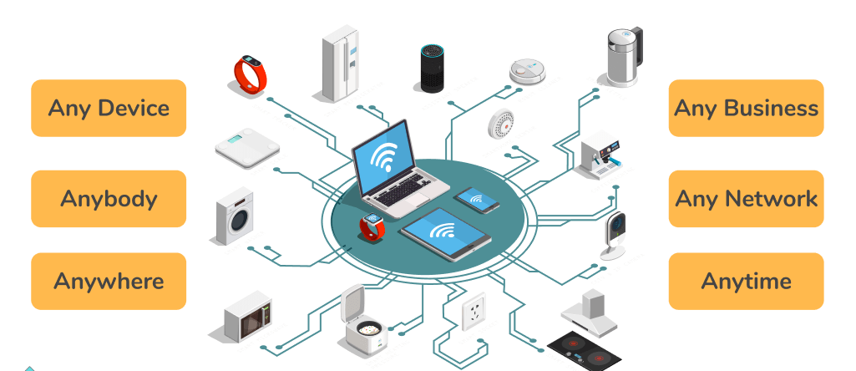
Looking deeper into IoT
Over the past few years, IoT has become one of the most important technologies of the 21st century. Now that we can connect everyday objects - kitchen appliances, cars, thermostats, baby monitors - to the internet via embedded devices, seamless communication is possible between people, processes, and things.
By means of low-cost computing, the cloud, big data, analytics, and mobile technologies, physical things can share and collect data with minimal human intervention. In this hyper-connected world, digital systems can record, monitor, and adjust each interaction between connected things. The physical world meets the digital world - and they cooperate.
Recently, industries have used machine-to-machine communication (M2M) to achieve wireless automation and control. But with the emergence of cloud and allied technologies (such as analytics and machine learning), industries can achieve a new automation layer and with it create new revenue and business models. The following are some common uses for IoT:
  Smart manufacturing
  Connected assets and preventive and predictive maintenance
  Smart power grids
  Smart cities
  Connected logistics
  Smart digital supply chains
Another extremely popular wireless technology used in retail, commercial, and industrial IoT is the Radio frequency identification (RFID) system. RFID use tags to store electronic information that can be communicated wirelessly via electromagnetic fields.

Slide 13
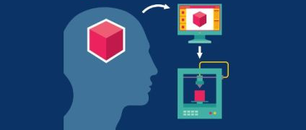
Additive Manufacturing
Using Computer Aided Design (CAD) or 3D object scanners, additive manufacturing allows for the creation of objects with precise geometric shapes. These are built layer by layer, as with a 3D printing process, which is in contrast to traditional manufacturing that often requires machining or other techniques to remove surplus material.
Components of Additive Manufacturing
3D printing
Rapid Prototyping
Selective Laser Sintering
Benefits of Additive Manufacturing for business
Efficient use of resources
Small-lot production
Rapid manufacturing
Agile manufacturing
Reverse engineering

Slide 14
Looking deeper into Additive Manufacturing
Technically, additive manufacturing can refer to any process where a product is created by building something up, such as molding, but it typically refers to 3-D printing.
Additive manufacturing was first used to develop prototypes in the 1980s - these objects were not usually functional. This process was known as rapid prototyping because it allowed people to create a scale model of the final object quickly, without the typical setup process and costs involved in creating a prototype. As additive manufacturing improved, its uses expanded to rapid tooling, which was used to create molds for final products. By the early 2000s, additive manufacturing was being used to create functional products. More recently, companies like Boeing and General Electric have begun using additive manufacturing as integral parts of their business processes.
To create an object using additive manufacturing, someone must first create a design. This is typically done using computer aided design, or CAD, software, or by taking a scan of the object someone wants to print. Software then translates the design into a layer by layer framework for the additive manufacturing machine to follow. This is sent to the 3-D printer, which begins creating the object immediately. It is possible to go directly from digital to physical object. Technically, 3D printers make physical parts from digital computer models. Software makes most of the decisions about how each part is made and controls the actual printing process. That means that 3D printers are a digitally driven manufacturing technique and fit alongside other digitally driven techniques such as CNC machining and laser cutting.
Additive manufacturing uses any number of materials, from polymers, metals, and ceramics to foams, gels, and even biomaterials.

Slide 15
Cloud Computing
Cloud computing is the delivery of on-demand computing services - from applications to storage and processing power - typically over the internet and on a pay-as-you-go basis.
Instant computing infrastructure, provisioned and managed over the Internet.
Delivery of hardware and software tools - to users over the internet
Delivery of applications-as-a-service.
Infrastructure-as-a-Service
Platform-as-a-Service
Software-as-a-Service
Benefits of Cloud Computing for business
  Reduced IT costs;
  Scalability;
  Business continuity;
  Collaboration efficiency;
  Flexibility of work practices;
  Access to automatic updates.

Slide 16
Useful links
https://www.youtube.com/watch?v=Y990kaGbJD0
Industry 4.0 - Germany's 4th industrial revolution
https://www.youtube.com/watch?v=GV8zPtqOyqg&t=109s
3D Printing Is Changing the World
https://www.youtube.com/watch?v=iVS-AuSjpOQ&t=4s
What is Digital Twin? How does it work?
https://www.youtube.com/watch?v=0KOUzeE0h8g
A cobot co-worker in manufacturing
https://www.mckinsey.com/capabilities/mckinsey-digital/our-insights/rewired-for-value-digital-and-ai-transformations-that-work?stcr=173E7E034E684531923A72A36859313F&cid=other-eml-alt-mip-mck&hlkid=68dbbe2e1f1c4daca23eb48697193dce&hctky=14939448&hdpid=e50aceca-feb9-401d-a12c-8430b206cb75
Rewired for value: Digital and AI transformations that work

Slide 17
Thank you for your attention!

